Slide 1
Conditionals – part 3
Barb Ericson
Georgia Institute of Technology
August 2005

Slide 2
Learning Goals
Understand at a conceptual and practical level
  How to use conditionals with > 2 possibilities
  How to sepia-tint a picture
  How to test for values in ranges
  How to posterize a picture

Slide 3

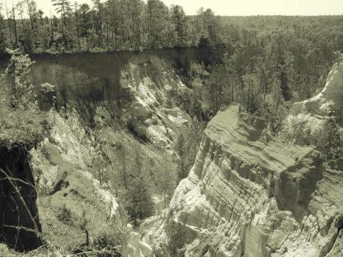
Sepia-Toned Pictures
Have a yellowish tint, used to make things look old and western

Slide 4
Sepia-toned Algorithm
First make the picture grayscale.
Loop through the pixels in the picture
  Change the shadows (darkest grays) to be even darker (0 <= red < 60)
  Make the middle grays a brown color (60 <= red < 190)
  Make the highlights (lightest grays) a bit yellow (190 <= red)
    Increase red and green
    Or decrease blue

Slide 5
Using Multiple If Statements
If we are doing different things based on a set of ranges
  0 <= x <= 5
  5 < x <= 10
  10 < x
if (0 <= x && x <= 5)
  Statement or block
if (5 < x && x <= 10)
  Statement or block
if (10 < x)
  Statement or block

Slide 6
Using “else if” for > 2 Options
If we are doing different things based on a set of ranges
  0 <= x <= 5
  5 < x <= 10
  10 < x
You don’t need to check if x > 5 since the first if block would have executed if it was
if (0 <= x && x <= 5)
  Statement or block
else if (x <= 10)
  Statement or block
else
  Statement or block

Slide 7
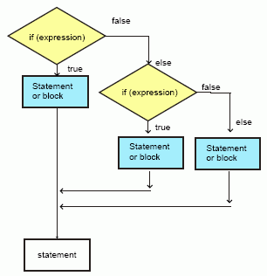
Conditionals with > 2 Choices
if (0 <= x && x <= 5)
{
}
else if (x <= 10)
{
}
else // what is x?
{
}

Slide 8
Sepia-toned Method
public void sepiaTint()
{
Pixel pixelObj = null;
double redValue = 0;
double greenValue = 0;
double blueValue = 0;
// first change the current picture to grayscale
this.grayscale();

Slide 9
Sepia-toned Method - Cont
// loop through the pixels
for (int x = 0; x < this.getWidth(); x++)
{
for (int y = 0; y < this.getHeight(); y++)
{
// get the current pixel and color values
pixelObj = this.getPixel(x,y);
redValue = pixelObj.getRed();
greenValue = pixelObj.getGreen();
blueValue = pixelObj.getBlue();

Slide 10
Sepia-toned Method - Cont
// tint the shadows darker
if (redValue < 60)
{
redValue = redValue * 0.9;
greenValue = greenValue * 0.9;
blueValue = blueValue * 0.9;
}
// tint the midtones a light brown by reducing the blue
else if (redValue < 190)
{
blueValue = blueValue * 0.8;
}

Slide 11
Sepia-toned Method - Cont
// tint the highlights a light yellow
// by reducing the blue
else
{
blueValue = blueValue * 0.9;
}
// set the colors
pixelObj.setRed((int) redValue);
pixelObj.setGreen((int) greenValue);
pixelObj.setBlue((int) blueValue);
}
}
}

Slide 12
Testing sepiaTint
String file = FileChooser.getMediaPath(“gorge.jpg”);
Picture p = new Picture(file);
p.explore();
p.sepiaTint();
p.explore();

Slide 13
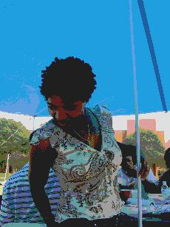
Posterize
Reducing the number of different colors in an image
Set all values in a range to one value (the midpoint of the range)
  Set all < 64 to 31
  Set all <128 to 95
  Set all < 192 to 159
  Set the rest to 223
Notes:
The image here is part of market.jpg after doing posterization.

Slide 14
Posterize Algorithm
Loop through all the pixels in an image
  Get the red value for the pixel
    Find the right range and set the new red value
  Get the green value for the pixel
    Find the right range and set the new green value
  Get the blue value for the pixel
    Find the right range and set the new blue value

Slide 15
Posterize Exercise
Write the method posterize() in the Picture.java class
  that will reduce the number of colors by changing color values to 1 of 4 values
    Set all 0 to 63 to 31 (< 64)
    Set all 64 to 127 to 95 (< 128)
    Set all 128 to 191 to 159 (< 192)
    Set all 192 to 255 to 223
Test with tammy.jpg

Slide 16
Summary
Use if, else if, and else for > 2 possiblities
  Add additional else if’s as needed
To sepia-tint a picture
  Change it to grayscale
  Make the shadows darker
  Make the middle grays brown
  Make the lightest grays yellow
To posterize a picture
  Change each color to the center of a range of colors

